Slide 1
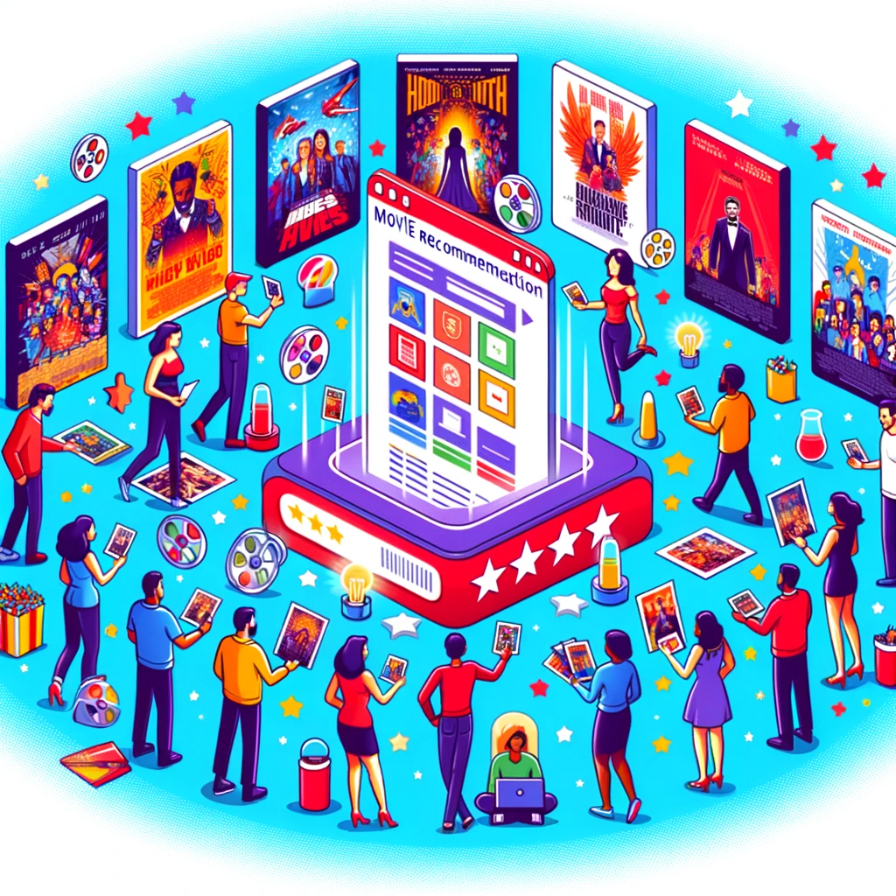
Innovative Movie Recommendation System for Diverse Groups
Vesa Haaparanta
Martti Grönholm

Slide 2
The Intricacy of Group Movie Selection
Imagine this: Mikko is passionate about sci-fi thrillers, Aino adores heartfelt dramas, and Leevi is fascinated by historical epics. However, Mikko finds dramas dull, and Aino isn't interested in historical stories.
Choosing a movie for Friday's movie night is quite a challenge. An action-packed thriller might captivate Mikko and Leevi, but it could leave Aino craving more emotional depth.
How can we pick a film that pleases everyone? With such varied preferences, it's evident that a standard solution won't work. For our film-loving group and wider gatherings, we need a strategy that respects their unique tastes and discovers a shared cinematic interest.

Slide 3
Steps of this recommendation system
Personalized Data Matrix
Compiling a bespoke matrix of movie ratings, unique to each group member.
Algorithmic Matchmaking
Employing a k-Nearest Neighbors algorithm to identify films resonating with the group's collective taste.
Embracing Diversity
Randomly selecting potential hits from a vast sea of unrated titles, ensuring a fresh roster every time.
Iterative Sequences
Generating not one but multiple recommendation sequences, each offering a new bouquet of cinematic experiences.

Slide 4
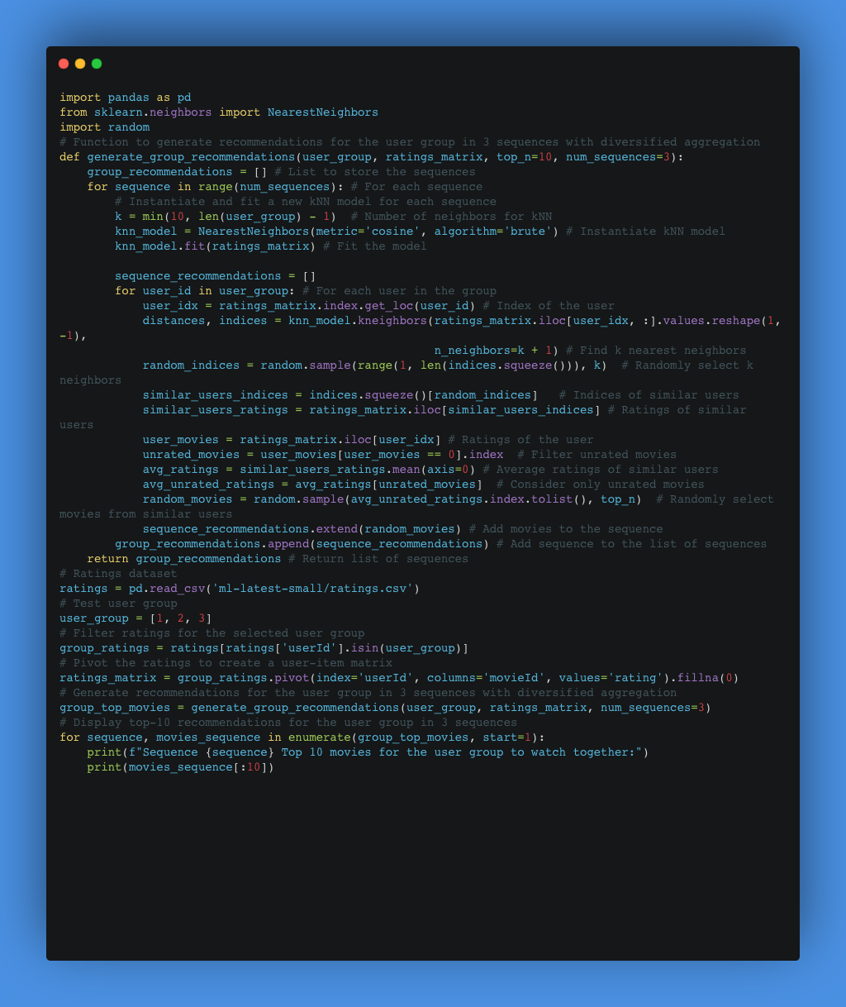

Slide 5
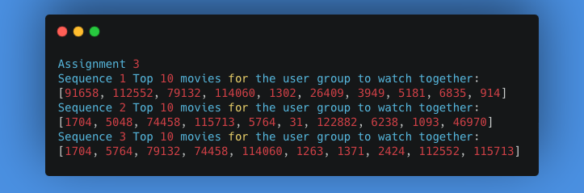
Conclusion
We can see that there is some movies which are in multiple sequences.
We can see that every sequence is unique to different sequences

